Slide 1


19CSE301 COMPUTER NETWORKS
3-0-3 4

Slide 2
APPLICATION LAYER
Learn about Application Layer protocols
DNS ( Domain Name System)
Peer to Peer Applications

Slide 3
Domain Name System ( DNS)
One identifier for a host is its hostname. Hostnames—such as cnn.com, www.yahoo.
com, gaia.cs.umass.edu, and cis.poly.edu.Because hostnames can consist of variable length
alphanumeric characters, they would be difficult to process by routers. For these reasons, hosts are also
identified by so-called IP addresses.
An IP address consists of four bytes and has a rigid hierarchical structure.
An IP address looks like 121.7.106.83, where each period separates one of the bytes expressed in decimal notation from 0 to 255.
An IP address is hierarchical because as we scan the address from left to right, we obtain more and more specific information about where the host is located in the Internet
People prefer the more mnemonic hostname identifier, while routers prefer fixed-length, hierarchically structured IP addresses
The Domain Name System (DNS) is the phonebook of the Internet. When users type domain names such as ‘google.com’ or ‘nytimes.com’ into web browsers, DNS is responsible for finding the correct IP address for those sites.

Slide 4
What happens when a URL is requested ?
Consider what happens when a browser (that is, an HTTP client), running on some user’s host, requests the URL www.someschool.edu/index.html. In order for the user’s host to be able to send an HTTP request message to the Web server www.someschool.edu, the user’s host must first obtain the IP address of www.someschool.edu. This is done as follows.
The same user machine runs the client side of the DNS application.
The browser extracts the hostname, www.someschool.edu, from the URL
and passes the hostname to the client side of the DNS application.
The DNS client sends a query containing the hostname to a DNS server.
The DNS client eventually receives a reply, which includes the IP address for
the hostname.
Once the browser receives the IP address from DNS, it can initiate a TCP connection to the HTTP server process located at port 80 at that IP address.
The desired IP address is often cached in a “nearby” DNS server, which helps to reduce DNS network traffic as well as the
average DNS delay

Slide 5
DNS: services, structure
why not centralize DNS?
single point of failure
traffic volume
distant centralized database
maintenance
A: doesn‘t scale!
DNS services
hostname to IP address translation
host aliasing
canonical, alias names
mail server aliasing
load distribution
replicated Web servers: many IP addresses correspond to one name
Application Layer
2-5

Slide 6
DNS Services: -
DNS provides following important services
Hostname to IP address translation , Host Aliasing, Mail server aliasing, Load distribution
Mail Server Aliasing : It is highly desirable that e-
mail addresses be mnemonic. However, the hostname
of the Hotmail mail server is more complicated and much less mnemonic than simply hotmail.com (for example, the canonical hostname might be something like relay1.west- coast.hotmail.com). DNS can be invoked by a mail application to obtain the canonical hostname for a supplied alias hostname as well as the IP address of the host.
MX record permits a company’s mail server and Web server to have identical (aliased) hostnames; for example, a company’s Web server and mail server can both be called enterprise.com.
Host aliasing. A host with a complicated hostname can have one or more alias names. For example, a hostname such as relay1.west- coast.enterprise.com could have, say,
two aliases such as enterprise.com and
www.enterprise.com. In this case, the
hostnamerelay1.westcoast.enterprise
.com is said to be a canonical hostname
DNS can be invoked by an application to obtain the canonical hostname for a supplied alias hostname as well as the IP address of the host
ost aliasing. A host with a complicated
ostname can have one or more alias names. For xample, a hostname such as relay1.west- oast.enterprise.com could have, say, wo aliases such as enterprise.com and ww.enterprise.com. In this case, the ostnamerelay1.westcoast.enterprise com is said to be a canonical hostname
NS can be invoked by an application to obtain the nonical hostname for a supplied alias hostname
s well as the IP address of the host

Slide 7
DNS Services: -
Load distribution:
DNS is also used to perform load distribution among replicated servers, such as replicated
Web servers
For replicated Web servers, a set of IP addresses is thus associated with one canonical hostname. The DNS database contains this set of IP addresses.
When clients make a DNS query for a name mapped to a set of addresses, the server responds with the entire set of IP addresses, but rotates the ordering of the addresses within each reply. Because a client typically sends its HTTP request message to the IP address that is listed first in the set, DNS rotation distributes the traffic among the replicated servers
DNS rotation is also used for e-mail so that multiple mail servers can have the same alias name.
The DNS is specified in RFC 1034 and RFC 1035, and updated in several additional RFCs

Slide 8
Why not centralize DNS?
A single point of failure. If the DNS server crashes, so does the entire Internet!
Traffic volume. A single DNS server would have to handle all DNS queries (for all the HTTP requests and e-mail messages generated from hundreds of millions of hosts).
Distant centralized database. A single DNS server cannot be “close to” all the querying clients. If we put the single DNS server in New York City, then all queries from Australia must travel to the other side of the globe, perhaps over slow and congested links. This can lead to significant delays.
Maintenance. The single DNS server would have to keep records for all Internet hosts. Not only would this centralized database be huge, but it would have to be updated frequently to account for every new host.
A centralized database in a single DNS server simply doesn’t scale

Slide 9
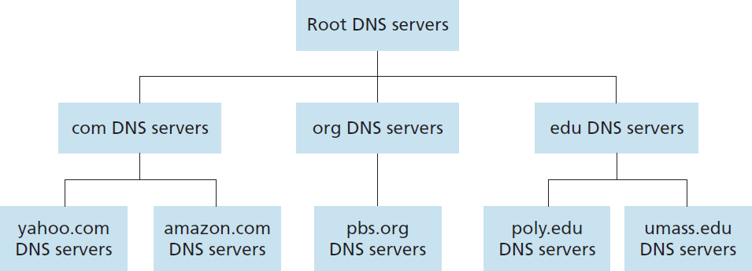
DNS: a distributed, hierarchical database
client wants IP for www.amazon.com; 1st approximation:
client queries root server to find com DNS server
client queries .com DNS server to get amazon.com DNS server
client queries amazon.com DNS server to get IP address for
www.amazon.com
In order to deal with the issue of scale, the DNS uses a large number of servers, organized in a hierarchical fashion and distributed around the world.
No single DNS server has all of the mappings for all of the hosts in the Internet. Instead, the mappings are distributed across the DNS servers
there are three classes of DNS servers— Root DNS servers, top-level domain (TLD) DNS
servers, and authoritative DNS server
Application Layer
2-9

Slide 10
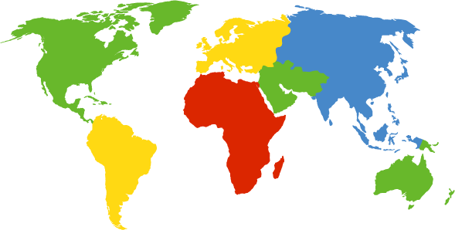
DNS: root name servers
contacted by local name server that can not resolve name
root name server:
contacts authoritative name server if name mapping not known
gets mapping
returns mapping to local name server
Although we have referred to each of the 13 root DNS servers as if it were a single server, each “server” is actually a network of replicated servers, for both security and reliability purposes.
All together, there are 247 root servers as of fall 2011.
c. Cogent, Herndon, VA (5 other sites)
d. U Maryland College Park, MD
h. ARL Aberdeen, MD
j. Verisign, Dulles VA (69 other sites )
k. RIPE London (17 other sites)
i. Netnod, Stockholm (37 other sites)
e. NASA Mt View, CA
f. Internet Software C.
Palo Alto, CA (and 48 other sites)
m. WIDE Tokyo
(5 other sites)
13 logical root name
“servers” worldwide
each “server” replicated many times
Verisign, Los Angeles CA (5 other sites)
USC-ISI Marina del Rey, CA
l. ICANN Los Angeles, CA (41 other sites)
g. US DoD Columbus,
OH (5 other sites)
Application Layer
2-10

Slide 11
TLD, authoritative servers
top-level domain (TLD) servers:
responsible for com, org, net, edu, aero, jobs, museums, and all top-level country domains, e.g.: uk, fr, ca, jp
Network Solutions maintains servers for .com TLD
Educause for .edu TLD
authoritative DNS servers:
organization’s own DNS server(s), providing authoritative hostname to IP mappings for organization’s named hosts
can be maintained by organization or service provider
Application Layer
2-11

Slide 12
Suppose a DNS client wants to determine the IP address for the hostname www.amazon.com.
To a first approximation, the following events will take place.
The client first contacts one of the root servers, which returns IP addresses for TLD
servers for the top-level domain com.
The client then contacts one of these TLD servers, which returns the IP address of an authoritative server for amazon.com.
Finally, the client contacts one of the authoritative servers for amazon.com, which
returns the IP address for the hostname www.amazon.com

Slide 13
Local DNS name server
does not strictly belong to hierarchy
each ISP (residential ISP, company, university) has one
also called “default name server”
When a host connects to an ISP, the ISP provides the host with the IP addresses of one or more of its local DNS servers
when host makes DNS query, query is sent to its local DNS server
has local cache of recent name-to-address translation pairs (but may be out
of date!)
acts as proxy, forwards query into hierarchy
Application Layer
2-13

Slide 14












DNS name resolution example
root DNS server
host at cis.poly.edu wants IP
address for gaia.cs.umass.edu
2
3
TLD DNS server
4
iterated query:
contacted server replies with name of server to contact
“I don’t know this name, but ask this server”
5
local DNS server
dns.poly.edu
7
6
1
8
authoritative DNS server
dns.cs.umass.edu
TLD server may not know the authoritative
DNS server for the hostname. Instead, the TLD server
requesting host
cis.poly.edu
may know only of an intermediate DNS server, which in turn knows the authoritative DNS server for the hostname.
gaia.cs.umass.edu
Application Layer
2-14

Slide 15





DNS name resolution example
root DNS server
2
3
recursive query:
puts burden of name resolution on contacted name server
heavy load at upper
levels of hierarchy?
7
6
TLD DNS
server
local DNS server
dns.poly.edu
1 8
5
4
authoritative DNS server
dns.cs.umass.edu
requesting host
cis.poly.edu
gaia.cs.umass.edu
Application Layer
2-15

Slide 16
DNS: caching, updating records
once (any) name server learns mapping, it caches mapping
cache entries timeout (disappear) after some time (TTL- Time To Live)
TLD servers typically cached in local name servers
thus root name servers not often visited
cached entries may be out-of-date (best effort name-to-address translation!)
if name host changes IP address, may not be known Internet- wide until all TTLs expire
update/notify mechanisms proposed IETF standard
RFC 2136
In a query chain, when a DNS server receives a DNS reply (containing, for example, a mapping from a hostname to an IP address), it can cache the mapping in its local memory
A local DNS server can also cache the IP addresses of TLD servers, thereby allowing the local DNS
server to bypass the root DNS servers in a query chain
Because hosts and mappings between hostnames and IP addresses are by no means permanent, DNS servers
discard cached information after a period of time (often set to two days).
2-16

Slide 17
DNS records
If a server is not authoritative for a hostname, then the server will contain a Type NS record for the domain that includes the hostname; it will also contain a Type A record that provides the IP address of the DNS server in the Value field of the NS record.
DNS:
distributed database storing resource records (RR)
type=A
name is hostname
value is IP address
type=NS
RR format: (name, value, type, ttl)
type=CNAME
name is alias name for some
“canonical” (the real) name
www.ibm.com is really
name is domain (e.g., foo.com)
value is hostname of authoritative name server for this domain
servereast.backup2.ibm.com
value is canonical name
type=MX
value is name of mailserver associated with name
If a DNS server is authoritative for a particular hostname, then the DNS server will contain a Type A record for the hostname
To obtain the canonical name for the mail server, a DNS client would query for an MX record; to obtain the canonical name for the other server, the DNS client would query for the CNAME record
Application Layer
2-17

Slide 18
DNS protocol, messages
query and reply messages, both with same message format
2 bytes 2 bytes
message header
identification: 16 bit # for query, reply to query uses same #
flags:
query or reply
recursion desired
recursion available
reply is authoritative
identification | flags
# questions | # answer RRs
# authority RRs | # additional RRs
questions (variable # of questions)
answers (variable # of RRs)
authority (variable # of RRs)
additional info (variable # of RRs)
Application Layer
2-18

Slide 19
DNS protocol, messages
2 bytes
2 bytes
 | identification |  | flags
 | # questions |  | # answer RRs
 | # authority RRs |  | # additional RRs
 |  | questions (variable # of questions)
 |  | answers (variable # of RRs)
 |  | authority (variable # of RRs)
 |  | additional info (variable # of RRs)
name, type fields
for a query
RRs in response
to query
records for authoritative servers
additional “helpful”
info that may be used
Application Layer
2-19

Slide 20
Inserting records into DNS
example: new startup “Network Utopia”
register name networkuptopia.com at DNS registrar (e.g., Network Solutions)
provide names, IP addresses of authoritative name server (primary and
secondary)
registrar inserts two RRs into .com TLD server:
(networkutopia.com, dns1.networkutopia.com, NS)
(dns1.networkutopia.com, 212.212.212.1, A)
create authoritative server type A record for www.networkuptopia.com; type MX record for networkutopia.com
Visit
//www.internic.net.
Application Layer
2-20

Slide 21
Chapter 2: outline
principles of network applications
Web and HTTP
electronic mail
SMTP, POP3, IMAP
DNS
P2P applications
video streaming and content distribution networks
socket programming with UDP and TCP
Application Layer
2-22

Slide 22





